Slide 1
Referee Expectations
Setting the tone for the crew

Slide 2
Agenda Topics
Getting your assignment
Pre-game communications
Pre-game meeting
Conversations with Coaches
Conversations with Captains
Other administrative responsibilities

Slide 3
Field Inspection
Can begin as you are walking down to the field
Goal posts covered, soccer nets back, pole vault pit covered?
Have we had bad weather lately?
Inform BOTH coaches of any issues
What lines result in illegal procedure foul to begin the game?
All other lines or field issues, put it in your game report

Slide 4
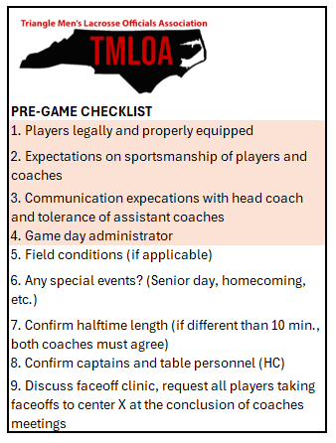
Meeting With Coaches
Professional but Brief
What are the mandatory items to cover?
Not a time to read the rulebook…
Can you meet with both coaches at once?

Slide 5
Meeting With Captains
Confirm expectations of sportsmanship
Acknowledge they are the leaders
Again… brief but professional. They are not there for us.
We are not the show, we are the facilitators of the show!
Flip the coin (what are the choices?)
Confirm the selections with the table, ensure they record the selections
“Congratulations on your selection as captains. You’ve been shown to exhibit good leadership both on the field and in the classroom, we expect that to continue here today. Blue talks to blue, white talks to white, no exceptions. Gentlemen, you have a veteran crew here today, and we are not here to throw flags. As long as you operate with the confines of the rulebook and good sportsmanship, you will not know we are here, and this officiating crew will have the best seat in the house for nothing but good competitive lacrosse! Any questions?”

Slide 6
Meeting With Faceoff Guys
Rules changes (if any)
Walk through the faceoff A to Z
Confirm expectations at each step of the faceoff
“Each official will vary their cadence”
“If you have any issues, let me know … we can solve it here at center X easier than we can solve it at the table area with your coach”
The goal is two-fold; conduct a fair faceoff, and get the game going as quickly as possible

Slide 7
Meeting With Table Personnel
One of the most important pregame tasks … also one of the most overlooked
Ensure the table is properly equipped
No Horn? No Book? No faceoff for the home team!
Be reasonable …
Give clear instructions and expectations
Know your audience
Most important; advise the table they are part of YOUR crew
If coaches give the table grief, they are giving the officials grief; handle accordingly

Slide 8
The Lineup
Goalies left shoulder is facing the cage of the goal they will defend
Ensure in-home is present, verbalize this to the referee
Referee reiterates expectations of sportsmanship
Keepers Cross!
And away we go…

